Slide 1
Cloud Prototyping SS19
Decentralized Energy Trading
Midterm Presentation

Slide 2
Table of Content
Task description and Motivation
Architecture
Current implementation
Blockchain
Household processing unit
Utility Contract (settlement algorithm)
Live demo
Following

Slide 3
Task description and Motivation

Slide 4
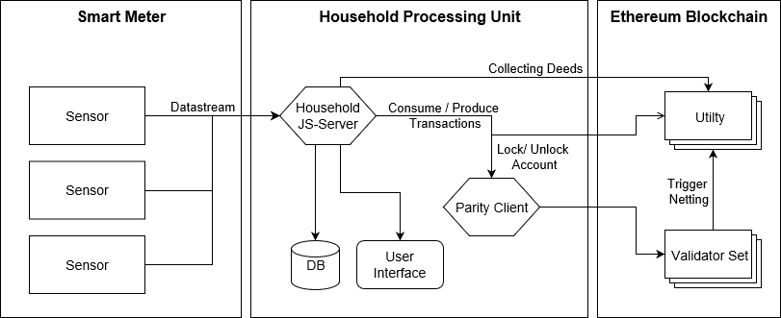
Architecture

Slide 5
Current implementation

Slide 6
Blockchain
PoA
Built on Parity (currently?)
Validator Set

Slide 7
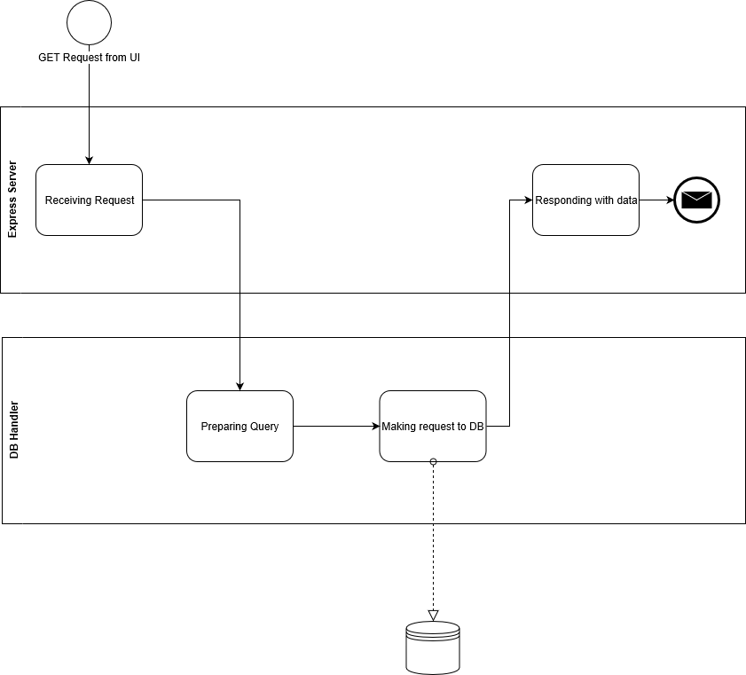
Household Server GET Request from UI

Slide 8
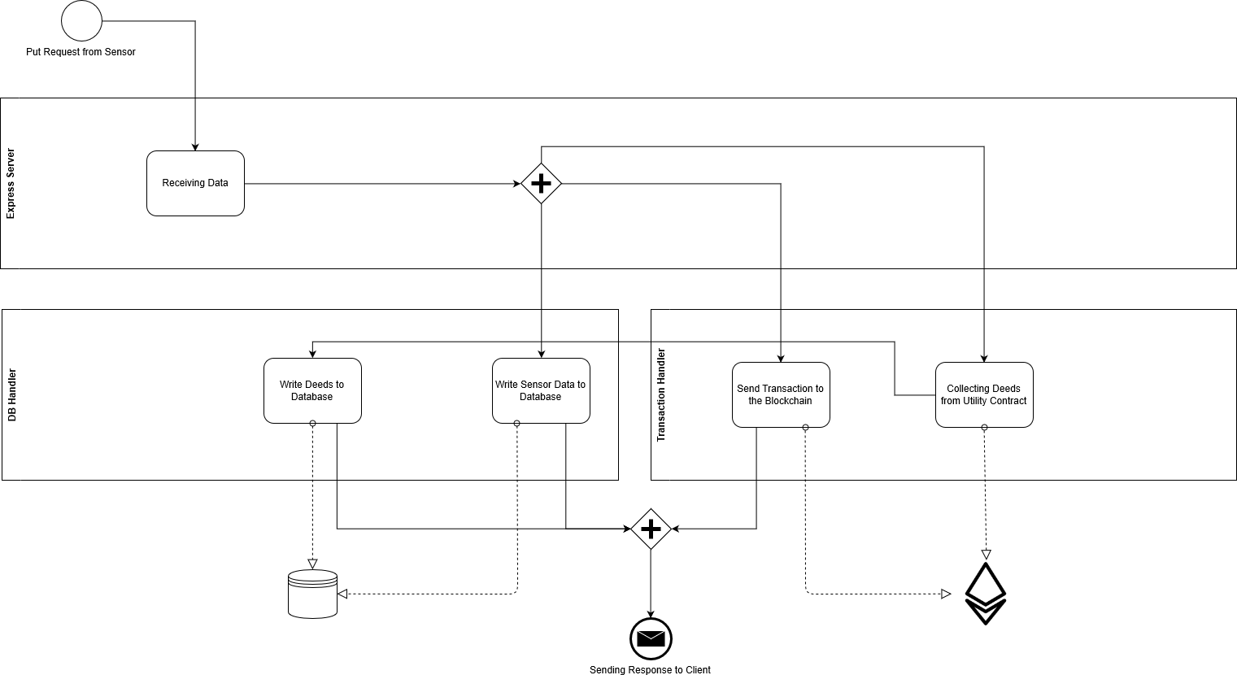
Household Server PUT Request from Sensor

Slide 9
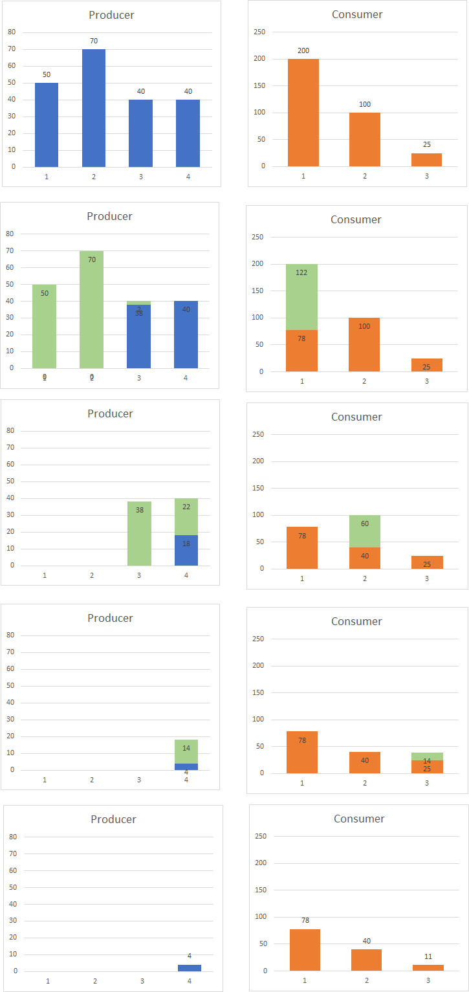
Settlement Algorithm

Slide 10
Live Demo

Slide 11
Following

